Slide 1

The Historical News Essay
Journalism History for the Public

Slide 2
News essay assignment
Write a 1,000-1,250-word news essay about the role of the press in the North Carolina election of 1898 and the Wilmington Massacre. You must develop a narrow topic that focuses your news essay. Your news essay must include either a news hook or a statement about why this history matters today.

Slide 3
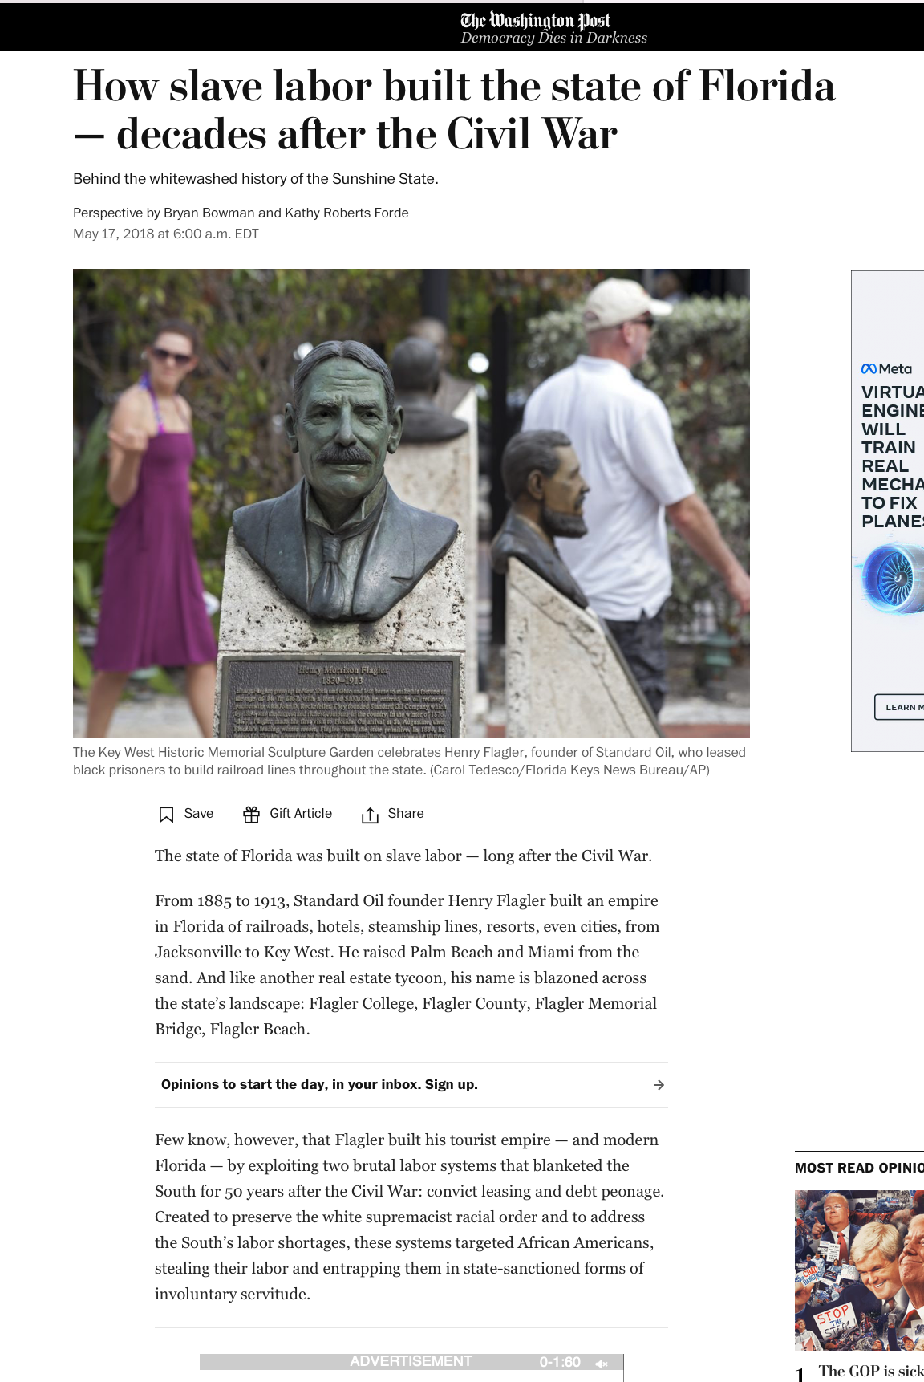
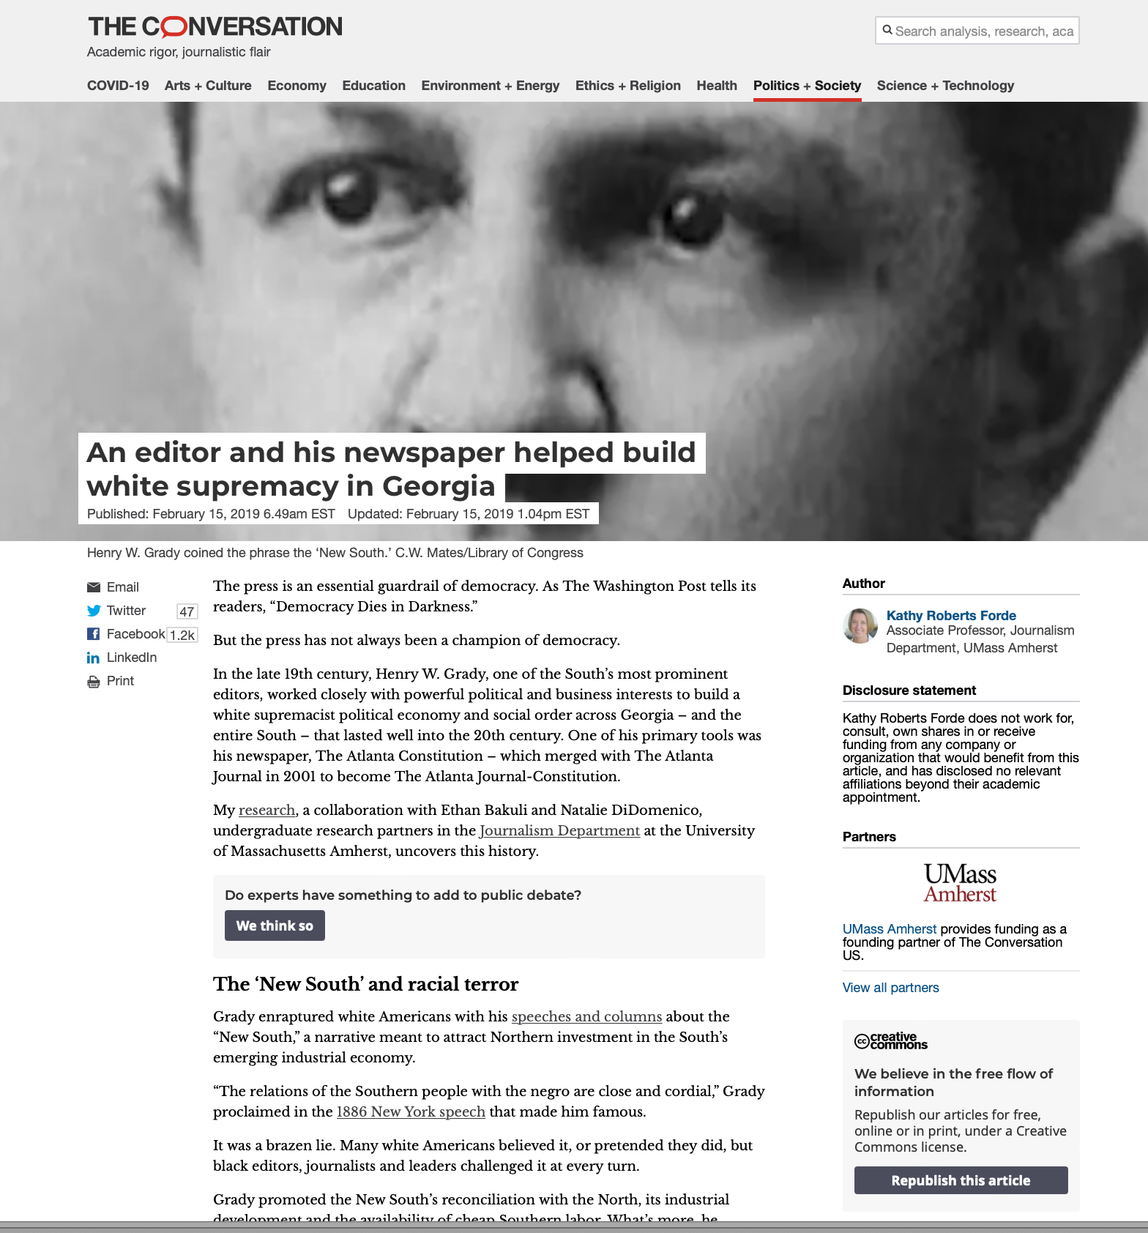
Models

Slide 4
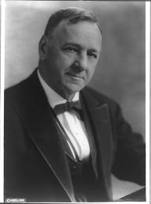
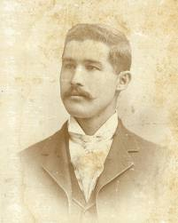
Josephus Daniels, publisher of the News & Observer—used the newspapers as a key instrument of the white supremacy campaign
Alexander Manly,
editor of the Daily Record in Wilmington (black daily), who wrote an editorial criticizing white hypocrisy re: interracial sexual relationships

Slide 5
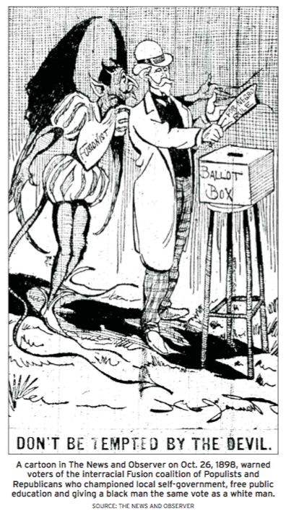
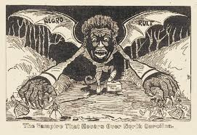

Slide 6
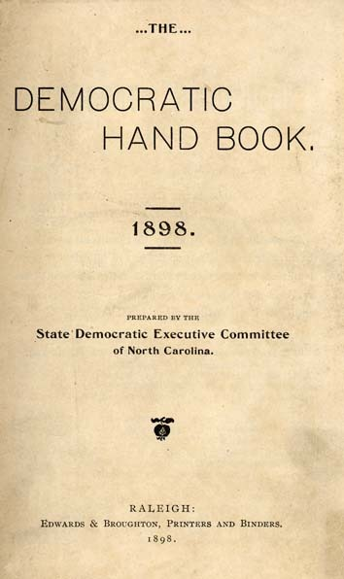

Slide 7
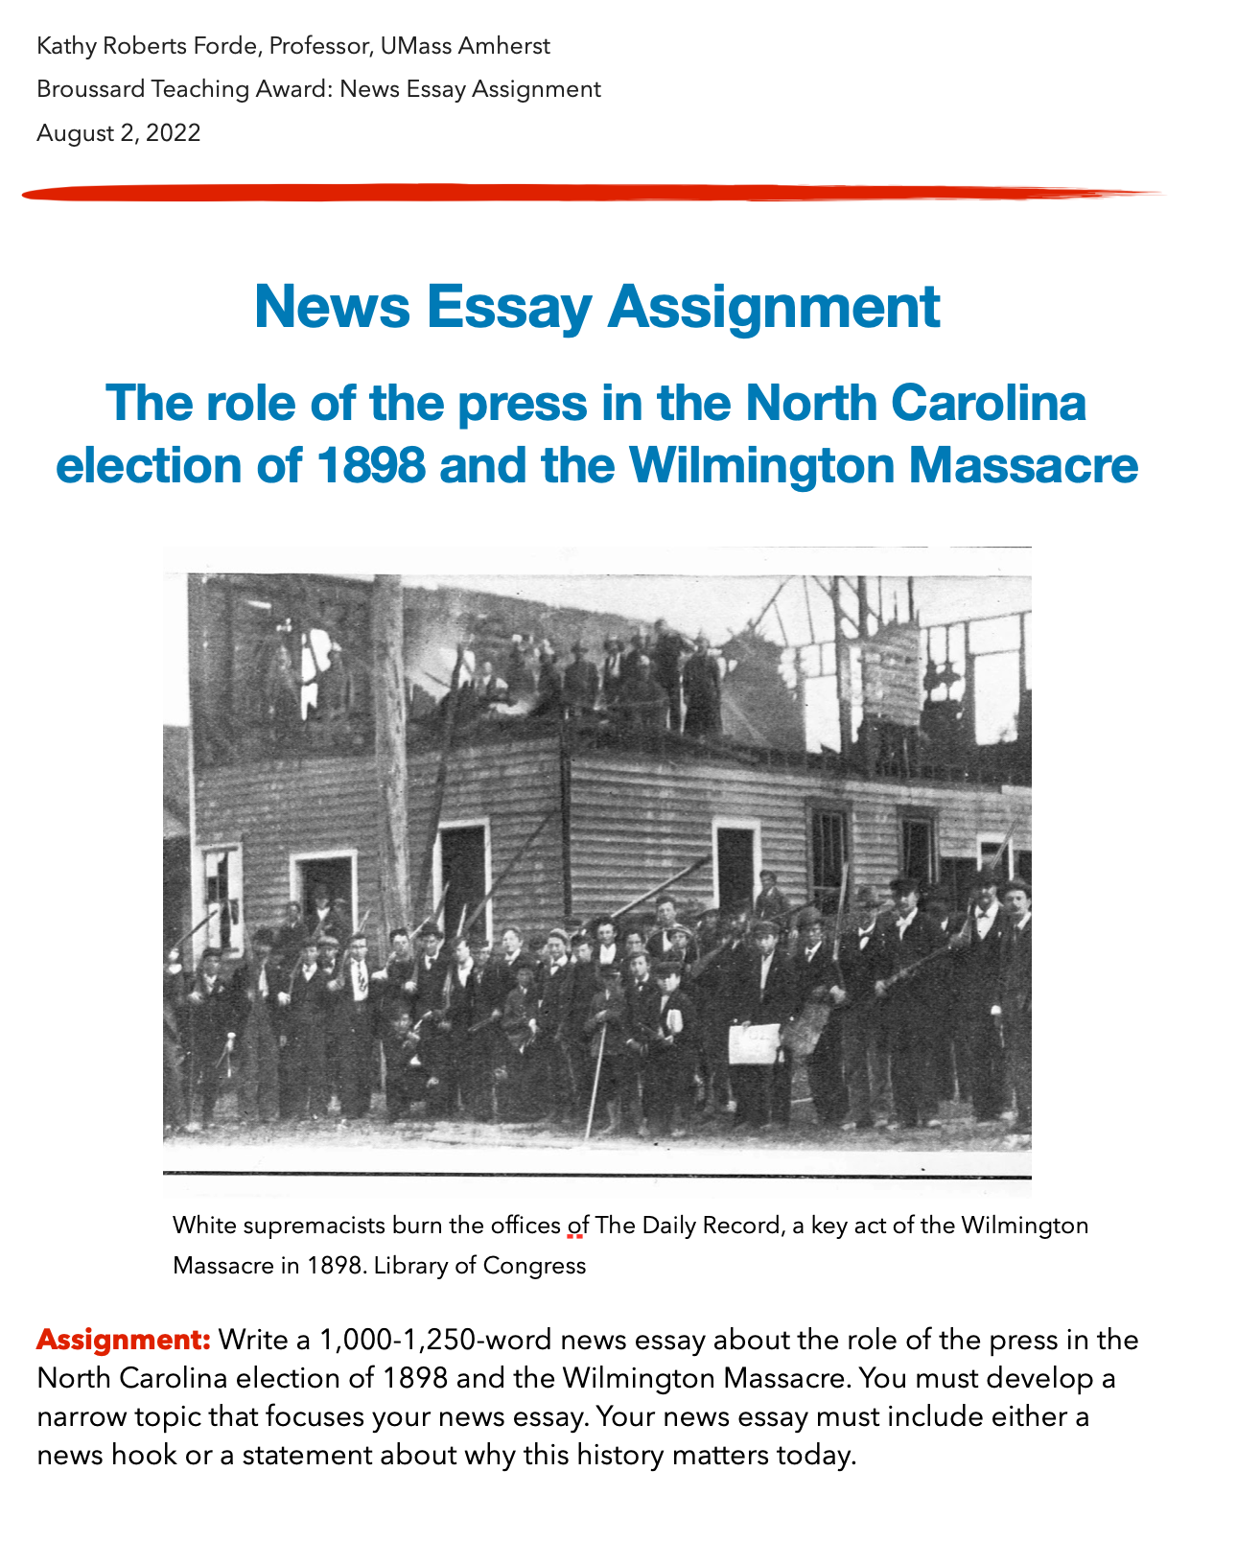

Slide 8
Digging into the historical record
Secondary sources
Primary sources
Report by the 1898 Wilmington Race Riot Commission, 2006
Raleigh News & Observer editorial, 2005
Raleigh News & Observer special report “The Ghosts of 1898,” 2006
Glenda Elizabeth Gilmore, Gender and Jim Crow: Women and the Politics of White Supremacy in North Carolina, 1896-1920 (University of North Carolina Press, 1996), chapter 4, “Sex and Violence in Procrustes’s Bed” (p. 91-118)
Kristin Gustafson, “Death of Democracy, North Carolina,” chapter 7, in Kathy Roberts Forde and Sid Bedingfield, eds., Journalism and Jim Crow: White Supremacy and the Black Struggle for a New America (p. 187-224)
Raleigh News & Observer political cartoons from the Democratic Party’s white supremacist campaign in North Carolina in 1898
Political cartoons; Democratic Party campaign handbook; news articles about rallies, speeches, etc.; brief biographies of key historical figures; timeline; Page of 3 8 and more on UNC Libraries’ digital exhibit The 1898 Election in North Carolina
Contemporaneous news coverage of the events in Wilmington in November 1898 after the election, PDFs of front pages of various newspapers from November 1898
Alexander Manly’s editorial in the Daily Record

Slide 9
Doing history together
Annotated model of published historical news essays that demonstrates structure, techniques, use of hyperlinks
Intensive, guided peer review workshop for first draft, with discussion of sources, topics, framing arguments, lede, nut graf, etc.
Follow-up peer review workshop for revised draft with focus on fact-checking

Slide 10
I’m happy to share all materials for this unit and assignment through Google Drive.
Feel free to edit for your own purposes.
Kathy Roberts Forde
kforde@umass.edu

